Slide 1
Typhoon HIL internship
Typhoon HIL, Inc.
Nikola Fischer Čelanović
CEO
Juliano Grigulo
Teodora Mijović
Mentor
tmijovic108@gmail.com
May 2023.

Slide 2
Agenda
Introduction - CHAdeMO
CAN bus protocol
Special features
Application demo
Simulation

Slide 3
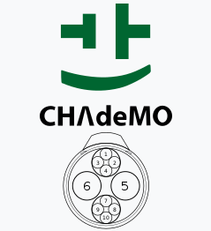
Introduction
CHAdeMO standard
“Charge de move” or “Ocha demo ikaga desuka” = “How about a cup of tea?”
First fast charging standard
Only DC charging supported
Communication via CAN bus
Master-Slave (BMS = Master, Charging station = Slave)
IEC 61851-24, Annex A

Slide 4
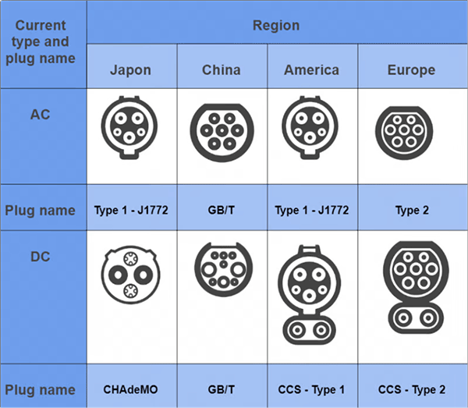
Introduction
Different plugs - IEC 62196

Slide 5
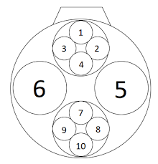
Introduction
CHAdeMO pinout
1 – protective conductor (PE) = protective earth
2 – charging sequence signal (d1)
3 – not connected
4 – charging sequence signal (k)
5 – DC-
6 – DC+
7 – proximity detection (CP)
8 – CAN – High
9 – CAN – Low
10 – charging sequence signal (d2)

Slide 6



CAN bus protocol
CAN Setup, CAN Send, CAN Receive
CAN Setup is used to configure the CAN controllers settings for the chosen HIL device (exactly one CAN Setup component must exist in the model)
CAN Send and CAN Receive are similar, we can choose the CAN controller, define the message’s ID, length, and how it is going to be exchanged (on an event or on timer)
Messages (manually defined or imported DBC files)

Slide 7
CAN messages
Messages IDs
CHAdeMO communication essentially comprises 5 CAN messages
3 for the vehicle side
2 for the charging station
EV
Message ID 0x100 - charge parameters
Message ID 0x101 - calculated charge time
Message ID 0x102 - signals for error marking
EVSE
Message ID 0x108 - charge parameters
Message ID 0x109 - signals for error marking

Slide 8
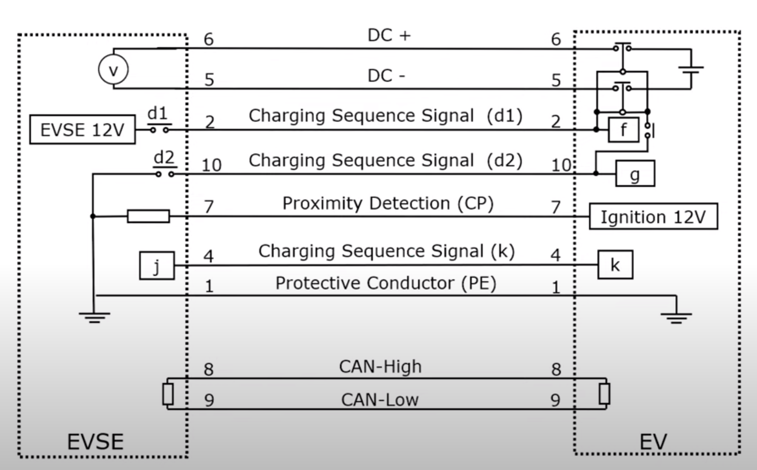
Circuit diagram

Slide 9
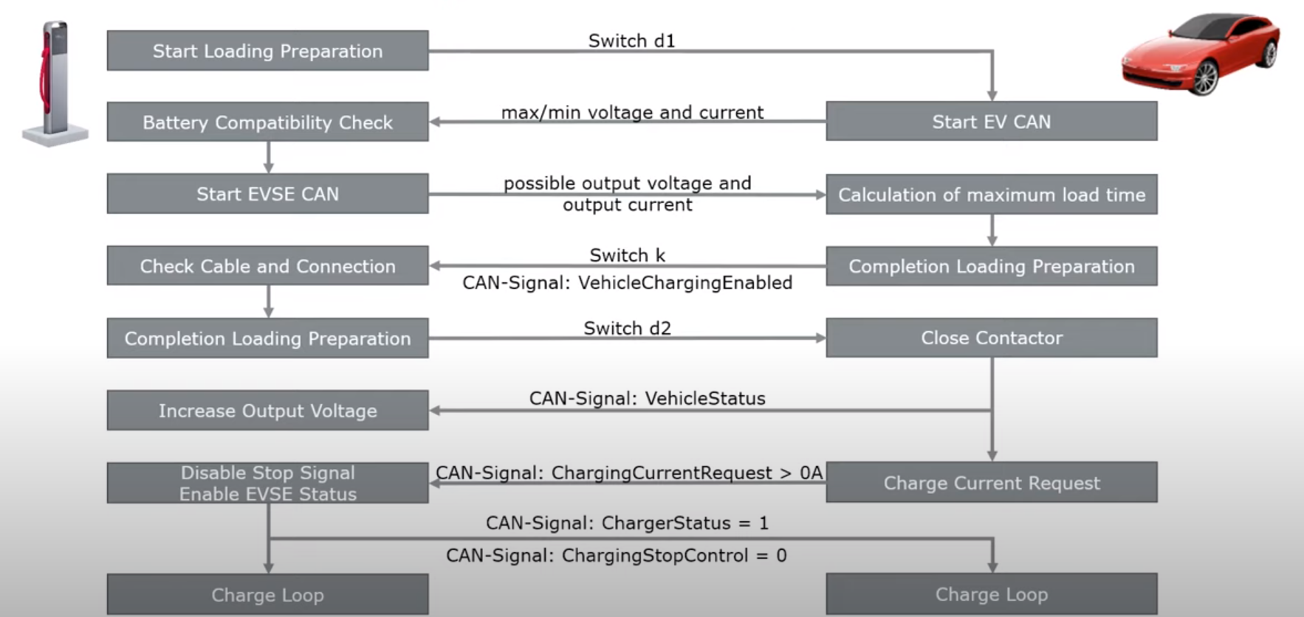
Communication flow

Slide 10
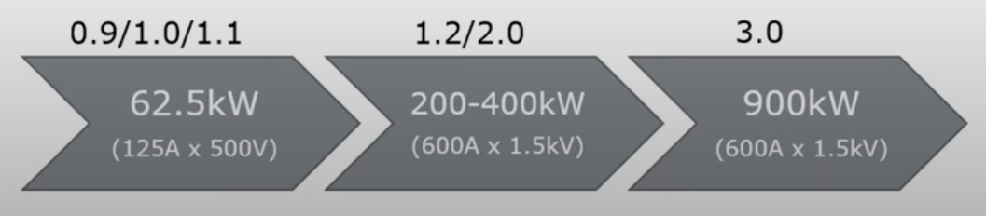
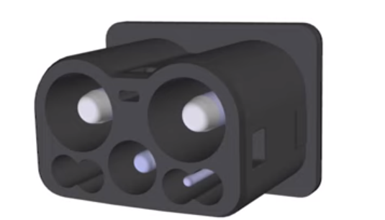
Special Features of CHAdeMO 2.0 and CHAdeMO 3.0
CHAdeMO 2.0
CHAdeMO 3.0
Dynamic control
Charging station can increase or decrease ”available output current” during charging
V2L/V2H/V2V
Vehicle to Load/Home/Vehicle
Bidirectional charging
Output voltage range extended to 150-1500Vdc
Output current range extended to 0-600Adc
Output power range extended to 0-900kW
New ChaoJi connector
Combines GBT (ChaoJi 1) and CHAdeMO (ChaoJi 2)
Changed and expanded communication

Slide 11
Introduction to the project
Based on github project
State of machine
Links
https://www.electricboxster.com/open-chademo
https://github.com/Isaac96/CHAdeMOSoftware

Slide 12
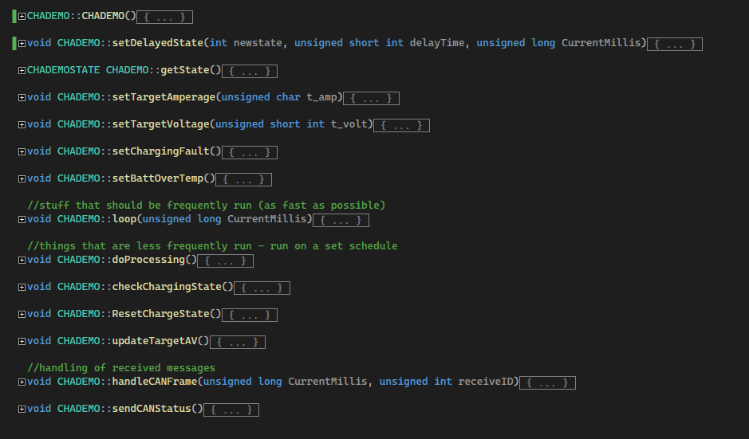
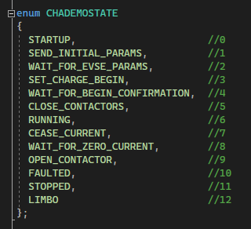
Charging process
Functions and states

Slide 13
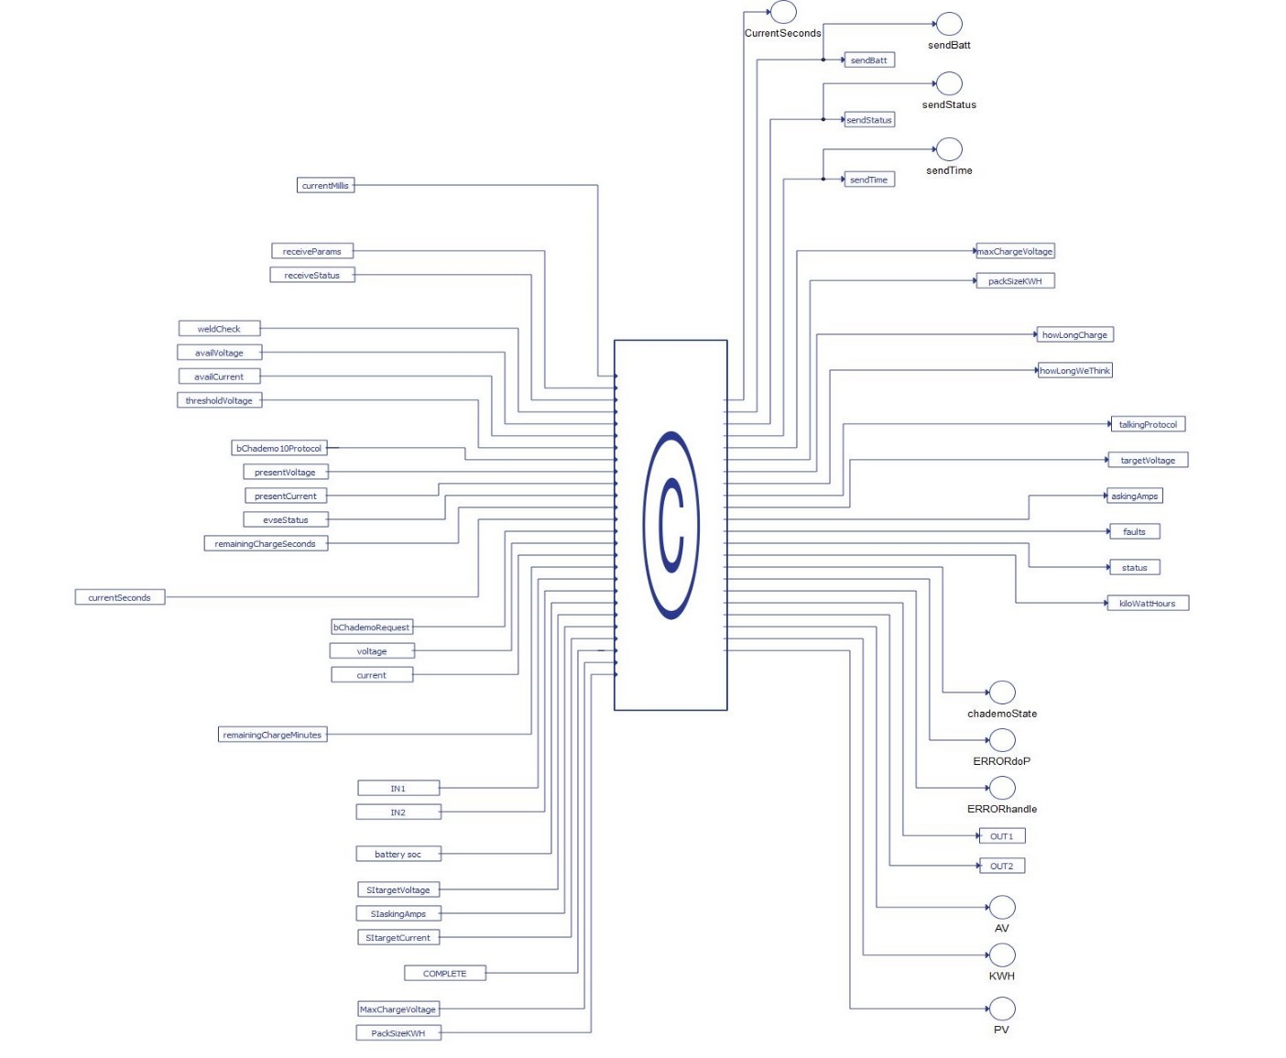
Advanced C Function block
Inputs
Received messages from EVSE
Outputs
Sent messages to EVSE
Logic of charging process
chademo.cpp

Slide 14
Simulation
Steps
1. Close contactor ”Charging cable” – physical connection between EV and EVSE
2. Close contactor ”d1” – signal IN1 goes high (signalizing us that connection is made)
3. Send EV’s parameters to EVSE (for example: battery specifications, charging time..)
4. Close contactor ”d2” – signal IN2 goes high (battery terminals are connected to the grid, charging starts)

Slide 15
Conclusion
Communication between EV and EVSE based on CHAdeMO standard (EV side)
Next Steps
Package manager – CHAdeMo EV component
Test with Vector CANoe
CHAdeMo 2.0
GB/T

Slide 16
Thank you for your attention!
Teodora Mijović
tmijovic108@gmail.com
May 2023.

